Slide 1

WELCOME to CVPA High School
Title I Annual Informational Meeting

Slide 2


Slide 3


Agenda
What is Title I?
Parent’s Rights Under Title I
Title I Funds
ESSA Compliant Procedure
Parents Right to Know
SParFEP
School-Parent Compact
Parent and Family Engagement Policy
Schoolwide Accountability Plan
Assessment

Slide 4

Purpose
All Title I schools are required to hold a Title I Annual meeting at the beginning of each school year to. . .
Inform parents/guardians about Title I programming; and
Share how parents and families can become involved and participate in the school

Slide 5

What is Title I?
The purpose of Title I is to provide ALL children “significant opportunity to receive fair, equitable, and high-quality education to close achievement gaps.”
As a Schoolwide program our school must develop a plan describing the services it will provide based on a comprehensive assessment of the school’s needs. This needs assessment must take into account the academic achievement of all students, particularly the needs of students struggling to meet state academic standards and any other factors as determined by the school district.

Slide 6

Title I Schools
Title I Schoolwide programs are required to. . .
Jointly develop with, and distribute to parents and family members a written Parent and Family Engagement Policy and update annually.
Convene an annual Title I Meeting to inform parents of their school’s participation in Title I and explain Title I requirements and the rights of parents to be involved.
Involve parents in an organized, ongoing and timely way in the planning, review and improvement of Title I programs.
Provide parents timely notification about programs under Title I.
Jointly develop with parents a school-parent compact and distribute annually.

Slide 7
Title I Funds
Schoolwide
$92,784.84
Parental Involvement
$3,413.42

Slide 8

Title I Program Funding
SLPS Method…
School wide programs use funds and resources to upgrade the entire educational program of the school in order to raise the academic achievement for all students.
Notes:
Computers, Classroom Promethean Board, New Chemistry Lab,
Dissecting pigs

Slide 9
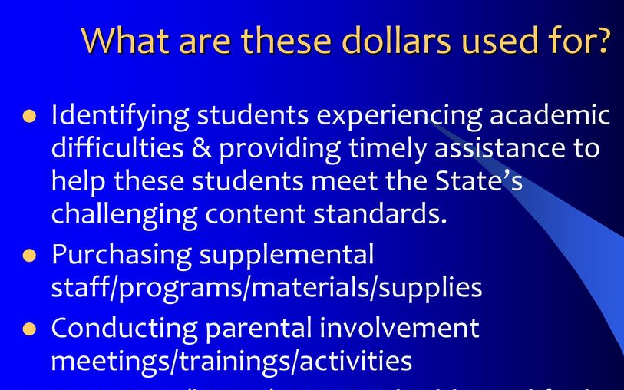
Title I Funds

Slide 10
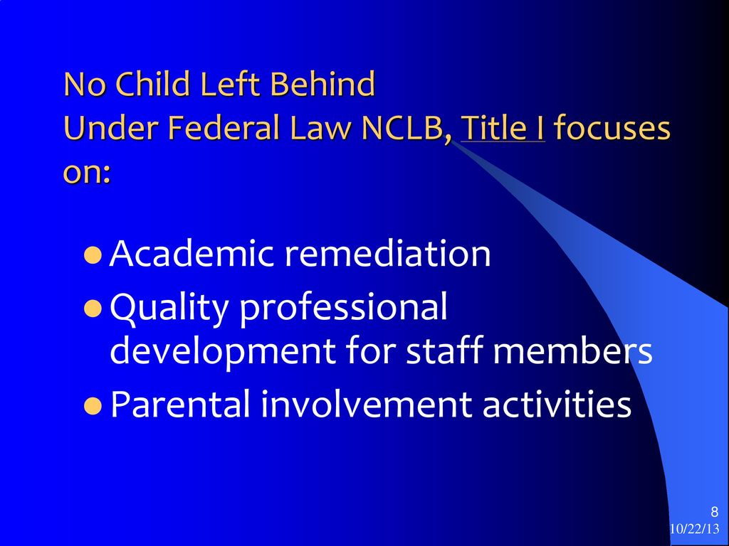

Slide 11
Title I Staff
Ms. Rovira- Academic Instructional Coach
Ms. Tatman- Family Community Specialist

Slide 12
Parent Family Engagement Policy
Title I served schools must involve parents in an organized, ongoing and timely way in the planning, review, and improvement of Title I programs, including the school’s parent and family engagement policy (plan) and the Schoolwide program plan.
Title I served schools must provide parents timely notification about programs under Title I, a description and explanation of curriculum at each school, the forms of assessments and achievement levels of the academic standards, and opportunities for regular meetings to discuss and participate in decisions related to their child’s educational program.

Slide 13
Parent and Family Engagement Policy
Every Title I school, in collaboration with parents, must develop a parent and family engagement policy/plan and reviewed on annual basis.
The parent and family engagement policy describes how the school will involve the parents in an organized, ongoing, and timely way in the planning, review and improvement of the Title I program at the school.
The Parent Involvement Action Plan provides a description of the opportunities of how parents can be involved utilizing the Epstein’s Model for Parent Involvement.
A copy of the plan should be on the the school’s website and made available to you upon completion.

Slide 14
2023-2024
School Parent and Family Engagement Policy
Central VPA High recognizes that a student’s education is a responsibility shared by the school and family. To support the goals of the school effectively, the school and parents must work as knowledgeable partners toward the educational success of their children. This plan will be distributed to parents annually and be revised periodically to meet the changing needs of parents and the school.

Slide 15
School Parent Compact
Each Title I served school jointly develops with parents a school-parent compact that outlines how parents, the entire school staff, and students share the responsibility for improved student academic achievement and how the school and parents will build a partnership to achieve this end.
The School-Parent Compact is a written agreement distributed to parents annually.

Slide 16
School-Parent-Student Compact
Central VPA High and the parents/guardians of the students participating in Title I.A. activities, services, and programs agree that this compact outlines how parents/guardians, the entire school staff, and students.

Slide 17


Slide 18
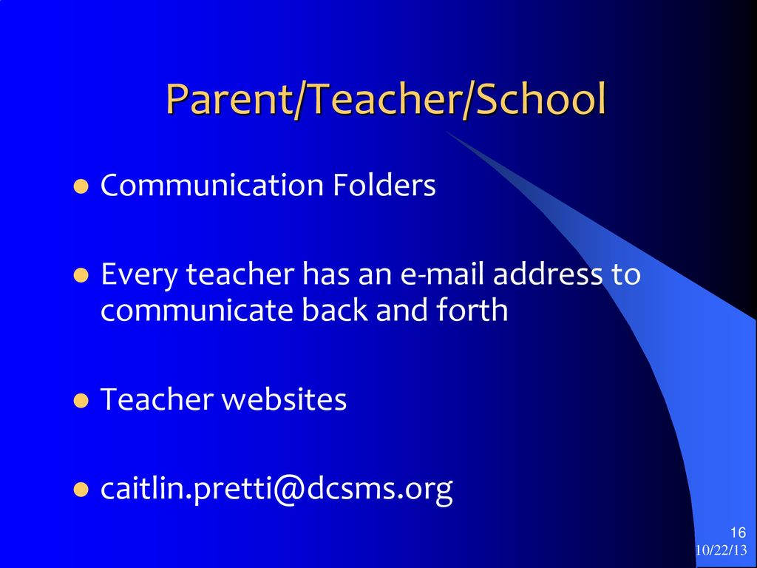

Slide 19

Parents’ Right to Know
Parents have the right to know about the teaching qualifications of your child’s classroom teacher and/or paraprofessional in a school receiving Title I funds.
YOU HAVE THE RIGHT TO KNOW
Whether the teacher has met State qualification and licensing criteria levels and subject areas in which the teacher provides instruction;
Whether the teacher is teaching under emergency or other provisional status through which State qualification or licensing criteria have been waived;
Whether the teacher is teaching in the field of discipline of the certification of the teacher; and
Whether your child is provided services by paraprofessionals and, if so, their qualifications.

Slide 20
National Network of Partnership
The St. Louis Public School Board uses the Joyce Epstein six different types of parental involvement framework.
Parenting
Communicating
Volunteering
Learning at Home
Decision Making
Collaborating with the Community
Notes:
The St. Louis Public School Board uses the Joyce Epstein six different types of parental involvement framework to actively engage parents, educators and community in developing effective relationships and partnership that will impact students achievement and school improvement

Slide 21
Parent Teacher Organization
Encourage parents to assist with various school activities/functions/services.
The parent teacher organization (PTO) supports Central VPA High School’s mission by promoting cooperation between parents, school, and staff.
We at Central VPA High realize that what parents do at home with your child is important to the total educational effort. We want our parents to value contributions at school and learning at home.
Volunteer Forms
Notes:
Football
Volunteer Form

Slide 22
PTO Parliamentary
President
Vice-President
Secretary
Treasure

Slide 23
Parent Action Council (PAC)
PAC- is a sounding board and an action network to address the concerns of SLPS families. In partnership with the Office of Family and Community Engagement, the PAC wants to help provide effective collaboration, among families, schools, and the community to support student academic development.
Contact: pac@slps.org
Website: http://www.slps.org/PAC
PAC Meetings

Slide 24
PTO Dates & Times
Tentatively*****
October 5:30-6:30PM
December 5:30-6:30PM
March 5:30-6:30PM
May 5:30-6:30PM

Slide 25
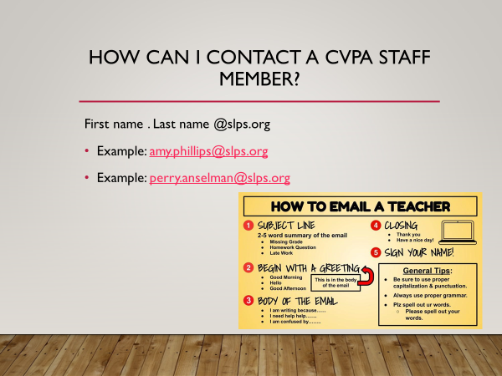

Slide 26
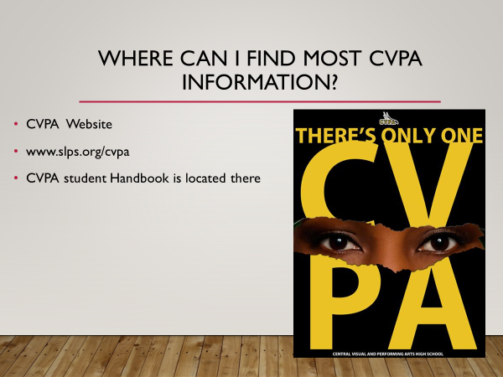

Slide 27

Follow Us

Slide 28

Questions?

